Slide 1
PART.1
Project Highlights:
Exception Handling:
Exception handling is implemented for potential errors during patient registration, providing appropriate error messages to enhance system stability.
Patients register and appointment system
power by Django
Appointment Number Generation:
The generate_appointment_number function is utilized to generate a unique appointment number, incorporating date, time, patient ID, and count for tracking and identification.
VINCENT AND KARINA
Dynamic Appointment Time Generation:
KARINA
The get_next_available_time function dynamically determines the next available appointment time for a patient based on existing appointment information and predefined morning and afternoon time slots.

Slide 2
PART.2
Register_Data_Introduction
Patients data Introduction:
Model
ID Signal
Patient Registration Form
Registration View
Registration Template
URL Configuration

Slide 3
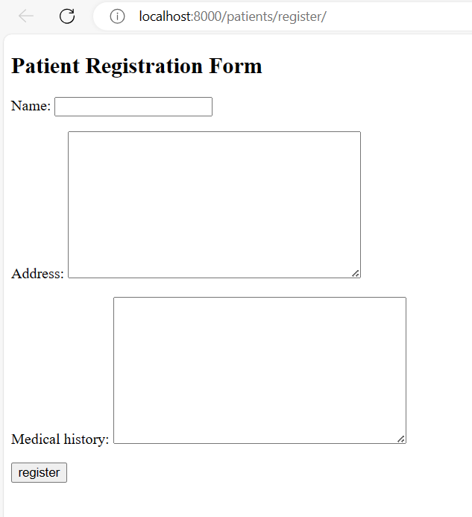
PART.3
REGISTRATION WAY: HTML AND SCRIPT
Patient’s name
Placement
Complaints

Slide 4
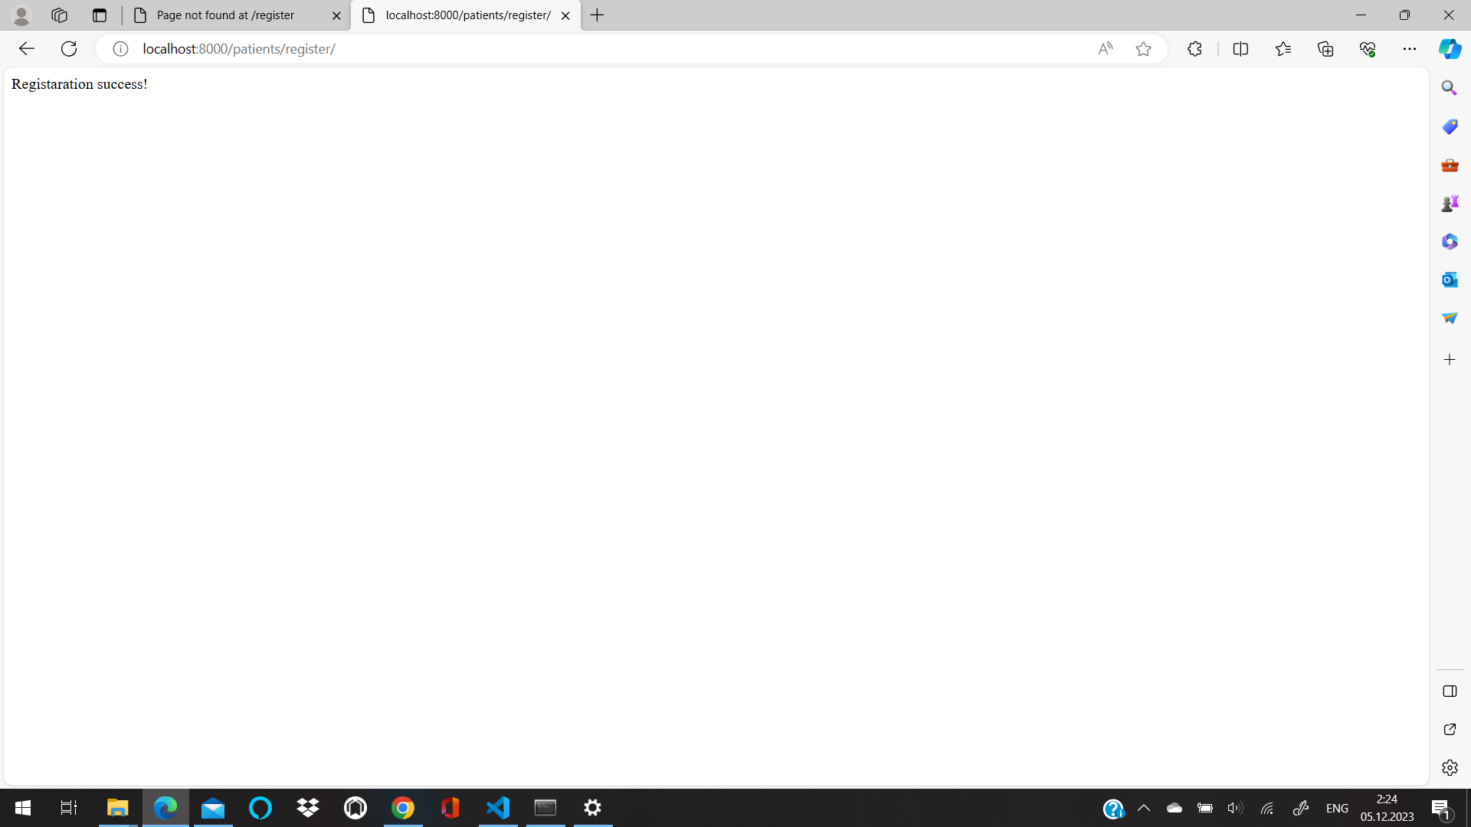
PART.3
REGISTRATION WAY: HTML AND SCRIPT
{ 'name': 'Clinton Carlson', 'address': '2713 Norman Lakes\nPittmanbury, GA 45124', 'medical_history': 'Behavior cover set anyone maintain. Loss question very white bank anything. Eat people score almost difficult claim.\nStyle security perform real thus say realize. Character line include learn.' }
import requests from faker import Faker fake = Faker() def generate_patient_data(): return { 'name': fake.name(), 'address': fake.address(), 'medical_history': fake.text() } def register_patient(data): url = 'http://127.0.0.1:8000/register/' print(f"Sending data to the server: {data}") response = requests.post(url, data=data) print(f"Server response: {response.text}")

Slide 5

PART.4
Book appointment(request)
can book appointment :
Purpose: Handles appointment booking requests.
Logic:
If it's a POST request, ensures the patient exists by their ID, gets the current date, and fetches the next available appointment time for the patient.
If there's an available time, creates an appointment object and returns success information along with appointment details.
If it's a GET request, renders an appointment booking page.
Returns: Returns a JSON response containing success information, appointment date, time, and number, or an error message in case of an exception.
VINCENT

Slide 6
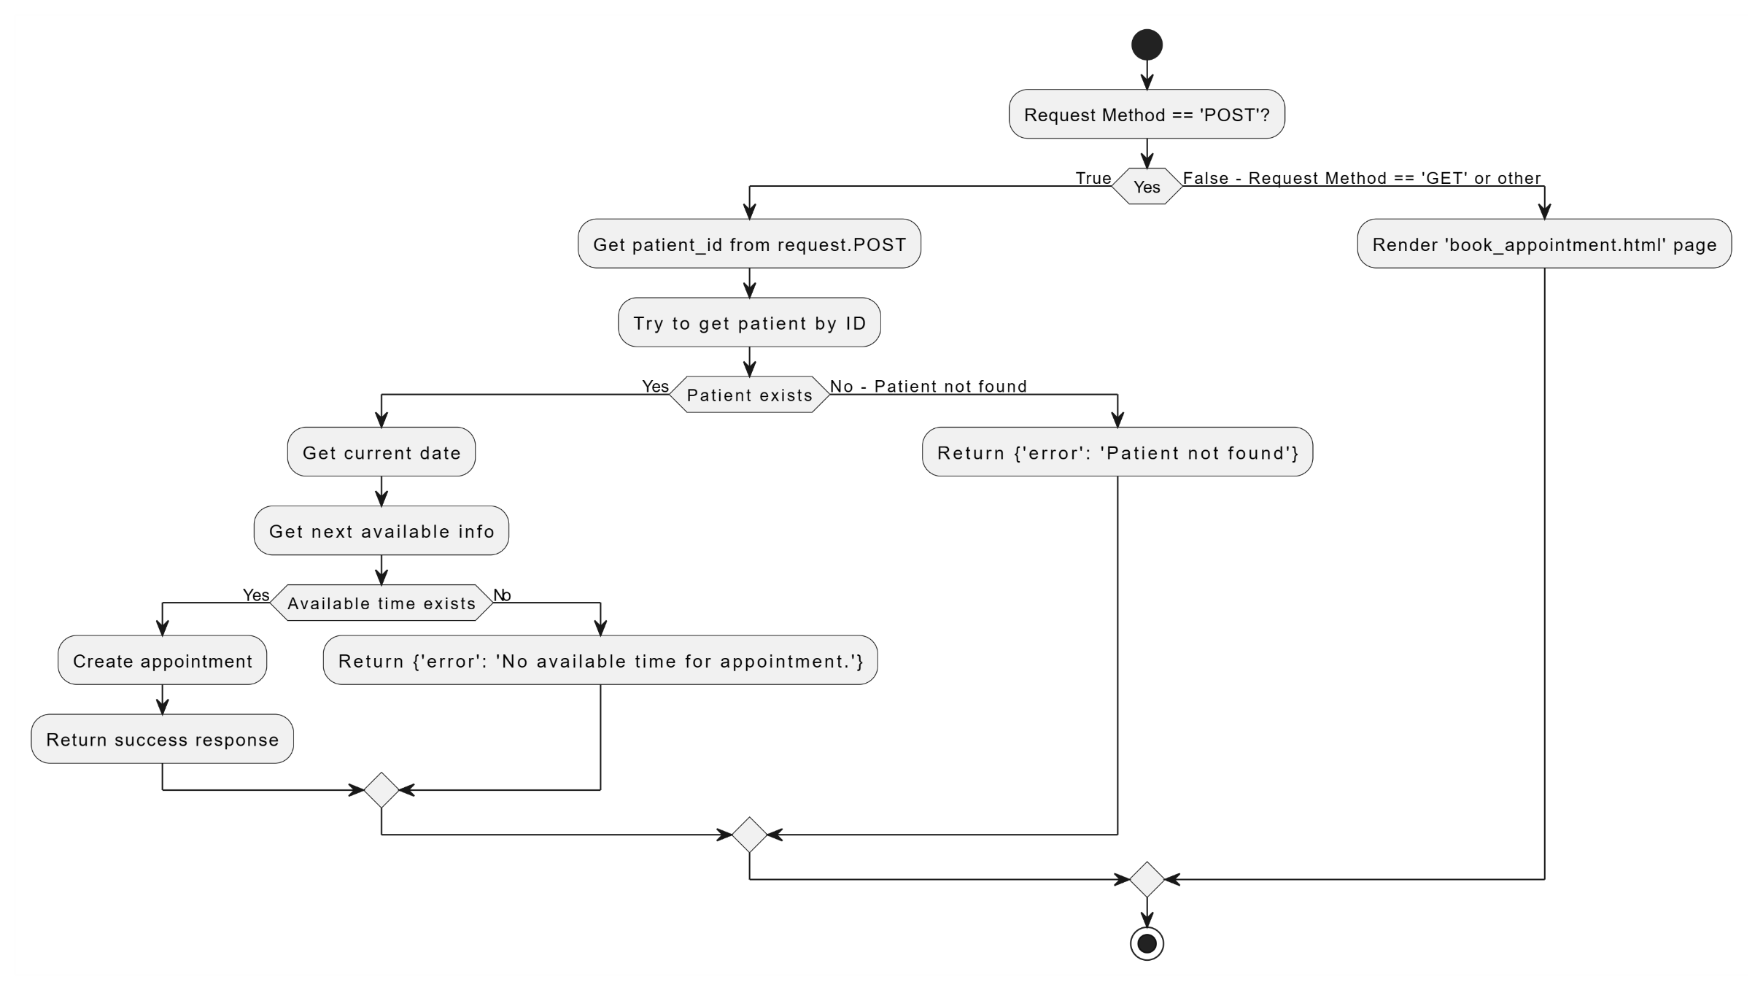
PART.4
MAKE APPOINTMENT

Slide 7
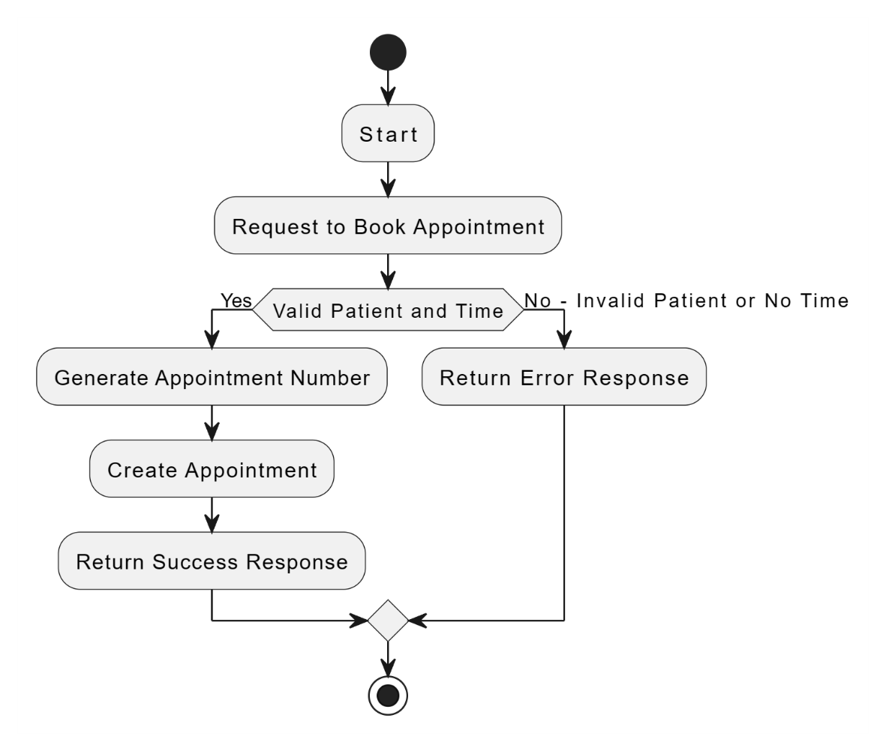
PART.5
generate_appointment_number(appointment_date, appointment_time, patient_id, count)
CREATE UNIQUE APPOINTMENT NUMBER
Purpose: Generates a unique appointment number.
Logic:
Converts the appointment date to a string and generates a suffix based on the appointment time.
Formats the count as a two-digit number and constructs the complete appointment number.
Returns: Returns a string representing the appointment number with date, time, patient ID, and count.
PPT模板 http://www.YPPPT.com/moban/

Slide 8
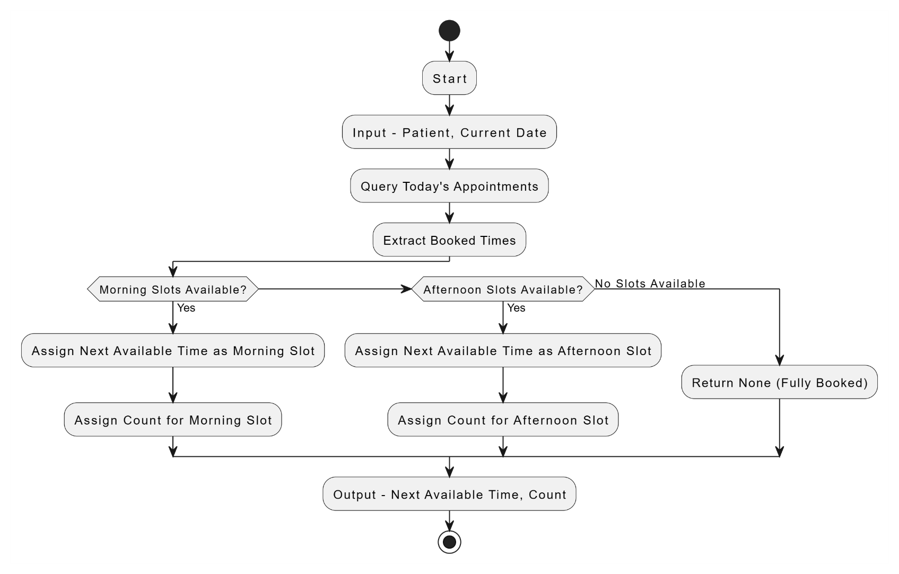
PART.6
get_next_available_time(patient, current_date)
AVAILABLE TIME CHECK
Purpose: Retrieves the next available appointment time for a patient.
Logic:
Queries existing appointment times for today, checks if there's available time in the morning or afternoon.
If available, returns the next available time and the corresponding count.
Returns: Returns a dictionary containing the next available time and count, or None if appointments are fully booked.
Notes:
https://www.ypppt.com/

Slide 9





THANK YOU FOR WATCHING
KARINA AND VINCENT

